Slide 1
Classifier Performance Comparison
Sergio Robledo

Slide 2
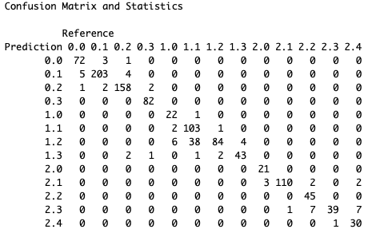
Random Forest Classifier
Accuracy
0.9109
Kappa
0.9001

Slide 3
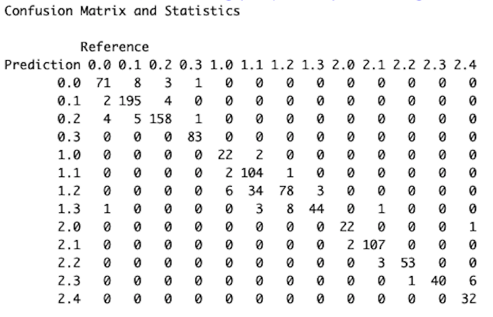
K-Nearest Neighbors Classifier
Accuracy
0.9082
Kappa
0.8973

Slide 4
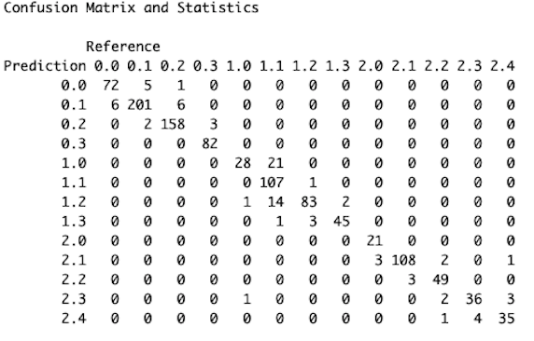
Support Vector Classifier
Accuracy
0.9226
Kappa
0.9134

Slide 5





Performance Metrics Graphed
The support Vector Classifier outperformed both Other Classifiers in all performance metrics. Therefore, it is the model chosen to predict building and floor location of an object given the RSSI from various Wireless access points.

